Slide 1
Intro to recommender systems
Nisheeth

Slide 2
Recommender systems
Algorithms
Applications
Evaluation
Usability/interface issues
Research Directions
Reading material
Main text: Recommender Systems Handbook, pdf available on HCC course page
I will mostly cover material from chapters 1,3,4,5,8,11
Bobadilla et al (2013) Recommender Systems survey
Dietmar et al (2013) Recommender Systems: an Introduction
Lots of materials in my slides from them

Slide 3
Taxonomy of information retrieval
Up front cost: what it costs the user to accept the information
Error cost: Cost to the system of retrieving bad information
Heterogeneity: Are different users likely to want different things
Frequency: How frequently do users use the service
Scale: What is the size of the corpus being queried per user
Query
User
System
Info

Slide 4
Taxonomy of factual web search
 | Low | Medium | High
Upfront cost | X
Error cost |  | X
Heterogeneity | X
Frequency |  |  | X
Scale |  |  | X

Slide 5
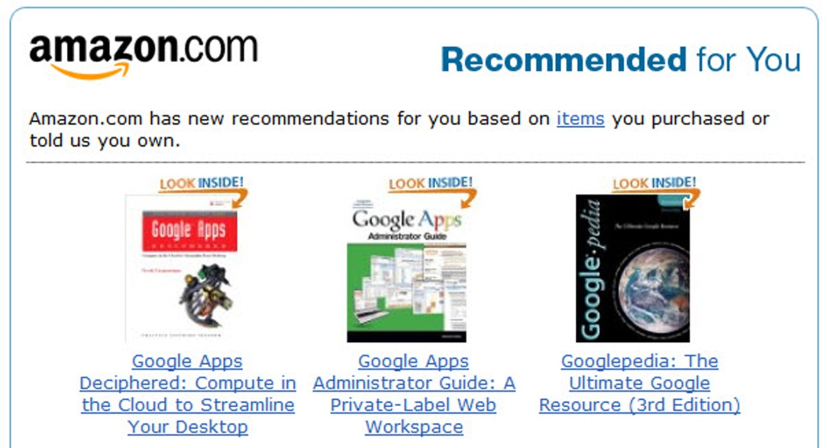
Product recommendations

Slide 6
Taxonomy of product recommendations
 | Low | Medium | High
Upfront cost |  | X
Error cost |  |  | X
Heterogeneity | X
Frequency | X
Scale |  |  | X

Slide 7
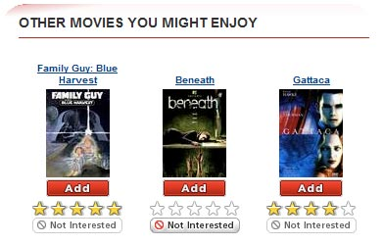
Consumption recommendations

Slide 8
Taxonomy of consumption recommendations
 | Low | Medium | High
Upfront cost |  |  | X
Error cost |  | X
Heterogeneity |  |  | X
Frequency |  | X
Scale |  | X

Slide 9
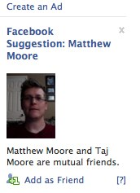
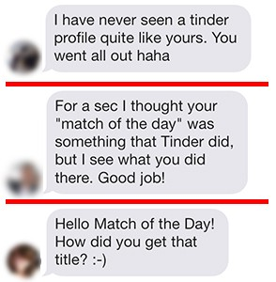
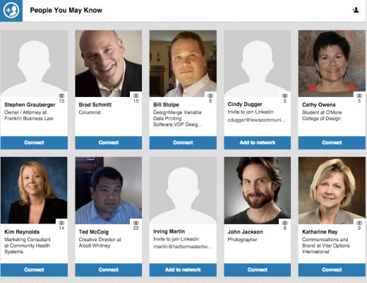
Social recommendations

Slide 10
Taxonomy of social recommendations
 | Low | Medium | High
Upfront cost | X
Error cost |  | X
Heterogeneity |  | X
Frequency |  | X
Scale | X

Slide 11
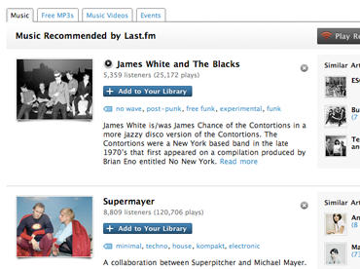
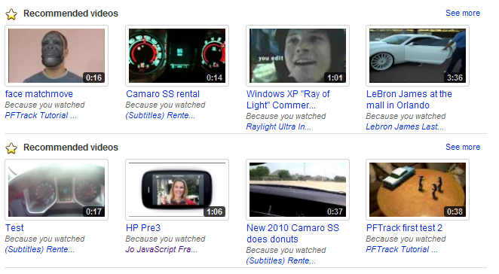
Experience recommendations

Slide 12
Taxonomy of experience recommendations
 | Low | Medium | High
Upfront cost | X
Error cost |  |  | X
Heterogeneity |  |  | X
Frequency |  | X
Scale | X

Slide 13
Typical data sources
Preference information
Implicit, e.g. dwell time
Explicit, e.g. Ratings
Content information
Implicit, e.g., user trends, item trends
Explicit, e.g. demographics, item features
Social information
Implicit, e.g. Friend graph, retailer brand
Explicit, e.g., Verified profiles, review counts
Context information
Implicit, e.g. Location, time, venue

Slide 14
Recommender system workflow
User
Item
Item ranking for user

Slide 15
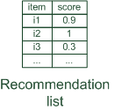
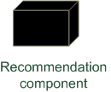
Types of recommender systems
Important algorithmic differences in recommender systems

Slide 16


Types of recommender systems
Personalized recommendations, e.g. Last.fm, delicio.us

Slide 17

Types of recommender systems
Content-based: "Show me more of the same what I've liked“, e.g. Pandora

Slide 18

Types of recommender systems
Collaborative: "Tell me what's popular among my peers“, e.g. Amazon

Slide 19


Types of recommender systems
Knowledge-based: "Tell me what fits based on my needs“, e.g. Shaadi.com

Slide 20
Types of recommender systems
Hybrid: combinations of various inputs and/or composition of different mechanism, e.g. Netflix, Youtube

Slide 21

Value proposition
To user
Reduce information search time
Discover new things
To server
Sell more
Know customers better

Slide 22
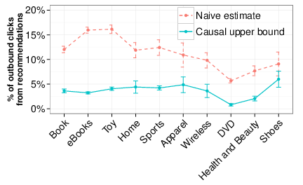
Myth vs. reality
Myth: 35% of Amazon product landings from recommender system
Reality: <10% really caused by recommender system
(Sharma, Hofman & Watts, 2015)

Slide 23
Content-based recommendation

Slide 24
Content-based recommendation
What do we need:
Some information about the available items such as the genre ("content")
Some sort of user profile describing what the user likes (the preferences)
The task:
Learn user preferences
Locate/recommend items that are "similar" to the user preferences

Slide 25
Types of recommender systems
Content-based: "Show me more of the same what I've liked"

Slide 26
What is the "content"?
The genre is actually not part of the content of a book
Most CB-recommendation methods originate from Information Retrieval (IR):
The item descriptions are usually automatically extracted (important words)
Goal is to find and rank interesting text documents (news articles, web pages)
Here:
Classical IR-based methods based on keywords
No expert recommendation knowledge involved
User profile (preferences) are rather learned than explicitly elicited

Slide 27
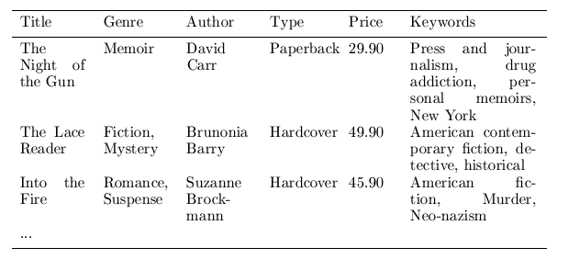
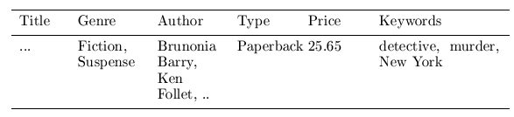

Content representation and item similarities
Simple approach
Compute the similarity of an unseen item with the user profile based on the keyword overlap (e.g. using the Dice coefficient)
sim(b_{i}, b_{j}) = $\frac{2 ∗|keywords\left(bi\right)∩keywords\left(bj\right)|}{\left|keywords\left(bi\right)\right|+|keywords\left(bj\right)|}$
Notes:
Intersection

Slide 28
Term-Frequency - Inverse Document Frequency (TF-IDF)
Simple keyword representation has its problems
In particular when automatically extracted because
Not every word has similar importance
Longer documents have a higher chance to have an overlap with the user profile
Standard measure: TF-IDF
Encodes text documents as weighted term vector
TF: Measures, how often a term appears (density in a document)
Assuming that important terms appear more often
Normalization has to be done in order to take document length into account
IDF: Aims to reduce the weight of terms that appear in all documents

Slide 29
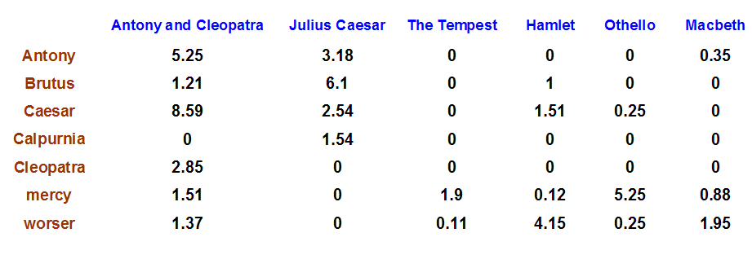
Example TF-IDF representation

Slide 30
More on the vector space model
Vectors are usually long and sparse
Improvements
Remove stop words ("a", "the", ..)
Use stemming
Size cut-offs (only use top n most representative words, e.g. around 100)
Use additional knowledge, use more elaborate methods for feature selection
Detection of phrases as terms (such as United Nations)
Limitations
Semantic meaning remains unknown
Example: usage of a word in a negative context
"there is nothing on the menu that a vegetarian would like.."
Usual similarity metric to compare vectors: Cosine similarity (angle)

Slide 31
Recommending items
Simple method: nearest neighbors
Given a set of documents D already rated by the user (like/dislike)
Find the n nearest neighbors of a not-yet-seen item i in D
Take these ratings to predict a rating/vote for i
(Variations: neighborhood size, lower/upper similarity thresholds)
Query-based retrieval: Rocchio's method
The SMART System: Users are allowed to rate (relevant/irrelevant) retrieved documents (feedback)
The system then learns a prototype of relevant/irrelevant documents
Queries are then automatically extended with additional terms/weight of relevant documents

Slide 32
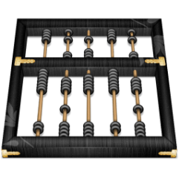

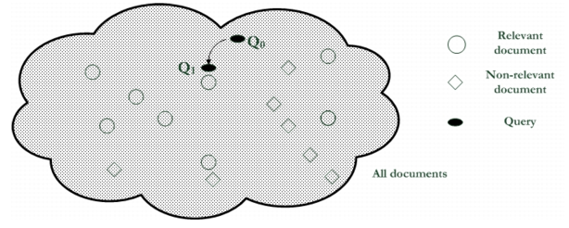
Rocchio’s algorithm
Document collections D⁺ and D⁻
α, β, γ used to fine-tune the feedback
often only positive feedback is used

Slide 33
Probabilistic methods
Recommendation as classical text classification problem
Long history of using probabilistic methods
Simple approach:
2 classes: like/dislike
Simple Boolean document representation
Calculate probability that document is liked/disliked based on Bayes theorem
P(Like|X)= k*P(X|Like) * P(Label=1)

Slide 34
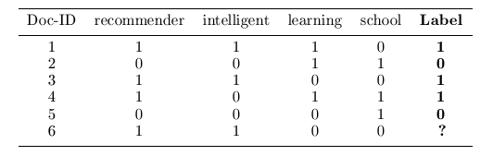
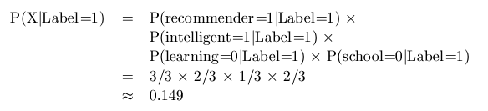
Simple NB example

Slide 35
Improvements
Side note: Conditional independence of events does not hold
“New”/ “York“ and “Hong” / “Kong"
Still, good accuracy can be achieved
Boolean representation simplistic
Keyword counts lost
More elaborate probabilistic methods
E.g. estimate probability of term v occurring in a document of class C by relative frequency of v in all documents of the class
Other linear classification algorithms (machine learning) can be used
Support Vector Machines, ..

Slide 36
Limitations of content-based recommendation methods
Keywords alone may not be sufficient to judge quality/relevance of a document or web page
Freshness, usability, aesthetics, writing style
Content may also be limited / too short
Content may not be automatically extractable (multimedia)
Ramp-up phase required
Some training data is required
Web 2.0: Use other sources to learn the user preferences
Overspecialization
Algorithms tend to propose "more of the same"
E.g. too similar news items

Slide 37
Best fit for
 | Low | Medium | High
Upfront cost | X
Error cost |  | X
Heterogeneity | X
Frequency | X
Scale | X

